Slide 1
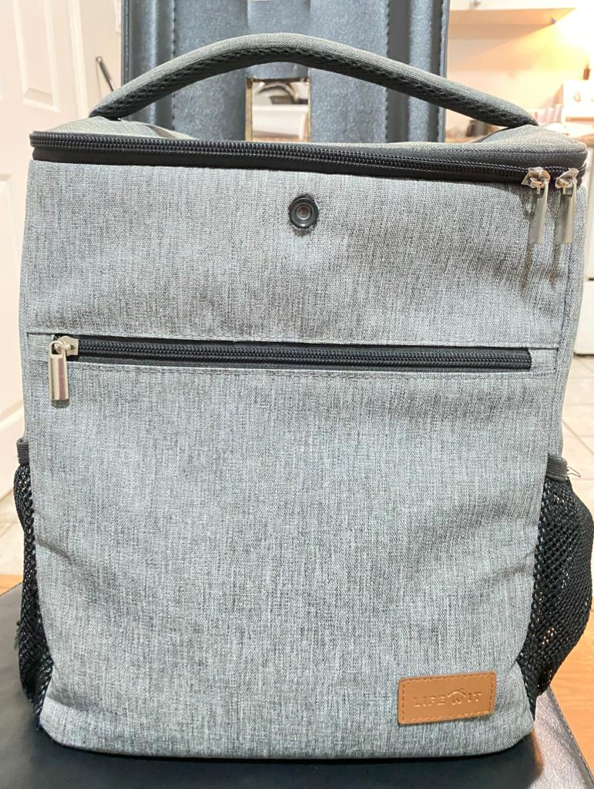
SMART BAG
PROJECT DONE BY:
STUDENT NAME | STUDENT ID
GOUTHAM REDDY ALUGUBELLY | C0747981
VISHAL HASRAJANI | C0761544
PARTH PATEL | C0764929
AMANDEEP SINGH | C0765434

Slide 2
PROJECT OVERVIEW
Smart bag is used for the pedestrians or the bicycle riders.
It can cover 360 degree view with dual cameras attached to it.
It can detect any major or minor accident with the accelerometer attached to it at the bottom.
It is also helpful in providing the location where the accident happened using the gps sensor.
You can connect your mobile network with the raspberry pi using the wifi option available.This will be helpful for sending your location to the cloud for further investigations.

Slide 3
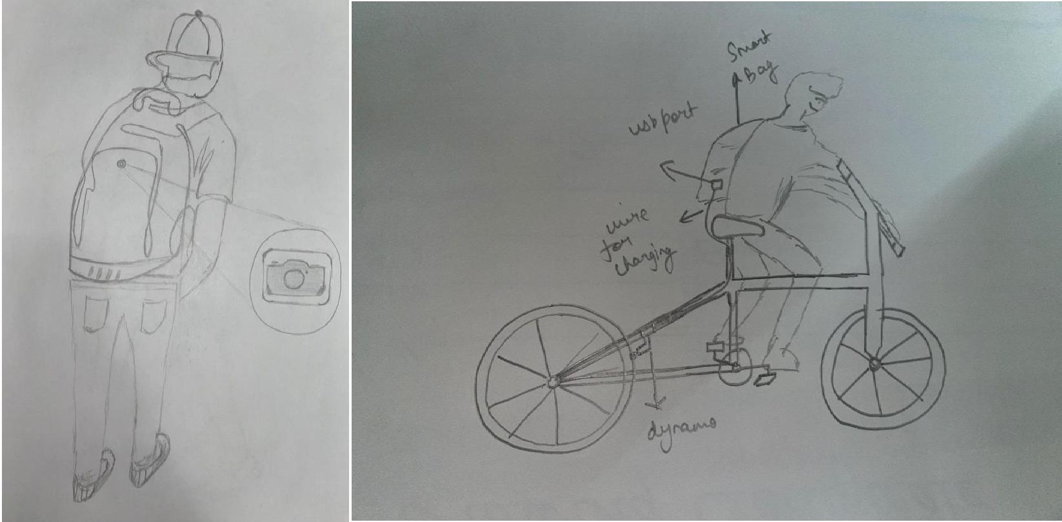
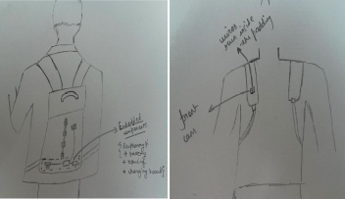

Slide 4
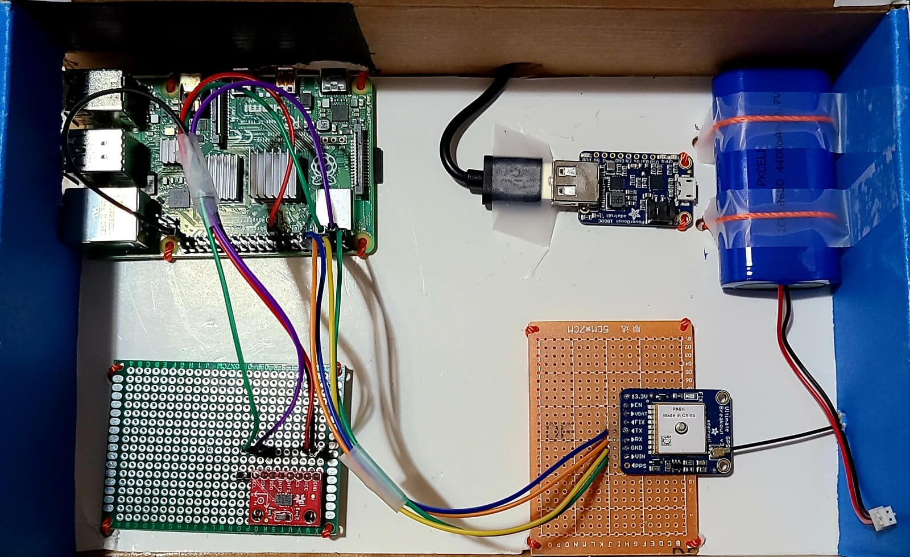

Slide 5
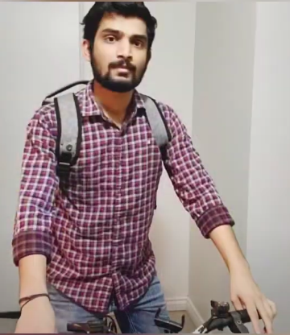
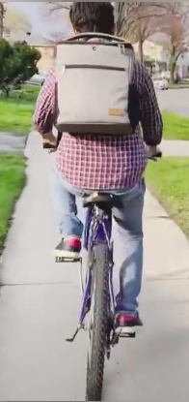
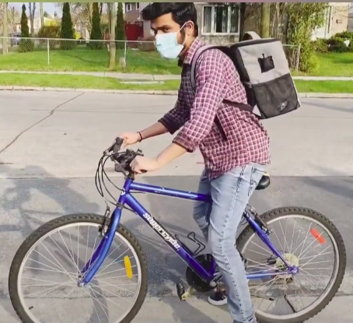

Slide 6
LINKS:
YOUTUBE VIDEO LINK FOR THE PROJECT
https://www.youtube.com/watch?v=it0PVX63UEs
LINK FOR UPLOADING GPS DATA IN TO AWS CLOUD
https://www.youtube.com/watch?v=Orav08EwEXI

